Slide 1

Some Important properties on Laplace Transformation
B tech CSE 2025 (Group - 6)
Dr. Sudip Chakrabarty
Notes:
We designed this template so that each member of the project team has a set of slides with its own theme. Members, here’s how you add a new slide to just your set:
Mark where you want to add the slide: Select an existing one in the Thumbnails pane, click the New Slide button, then choose a layout. The new slide gets the same theme as the other slides in your set.
Careful! Don’t annoy your fellow presenters by accidentally changing their themes. That can happen if you choose a different theme from the Design tab, which changes all of the slides in the presentation to that look.

Slide 2
Presented By
Ark jyoti Bakshi - A91005221011
Syed Abdus Salam - A91005221026
Dinank Adhikari - A91005221031
Hiranmay Mandal – A91005221053
Rajdeep Chakravarty - A91005221063
Raidoan Ahmed - A91005221061
Varun Jagaddeb - A91005221052

Slide 3
Topics to be covered
Introduction
Conclusion
First shifting Theorem
Change of scale property
Linearity
Time Shifting
Final Value Theorem
Differentiation
Integration

Slide 4
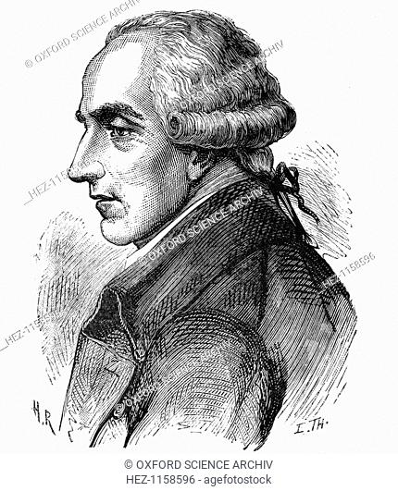
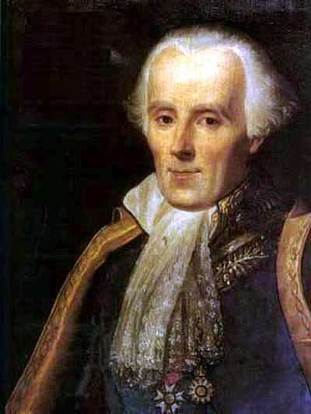
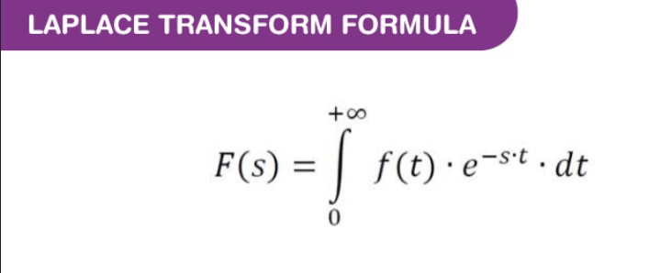
Introduction / Overview
What is Laplace Transformation?
The Laplace transform of a function is represented by L{f(t)} or F(s). Laplace transform helps to solve the differential equations, where it reduces the differential equation into an algebraic problem.
Laplace transform is named in honor of the great French mathematician, Pierre Simon De Laplace (1749-1827)

Slide 5
Linearity
Linearity: This property can be easily extended to more than two functions as shown in the proof given below. With the linearity property, Laplace transform can also be called the linear operator.
Let C1, C2 be constants. f(t), g(t) be the functions of time, t, then

Slide 6
Change of scale property:
If L{f(t)}=F(s)L{f(t)}=F(s), then,
L{f(at)}=1/a F(s/a)
Proof of Change of Scale Property L{f(at)}=∫∞0e−stf(at)dt
Let z=atz=at
t=z/at=z/a
dt=dza
when t=0,z=0
when t=∞,z=∞
L{f(at)}=∫∞0 e−s(z/a)f(z)dz/a
L{f(at)}=1/a∫∞0 e−(s/a)zf(z)dz
Hence, L{f(at)}=1aF(sa)
okay

Slide 7
INTEGRATION
If L{f(t)}=F(s) then
L[∫₀ f(u)du]=F(s)/s'

Slide 8
DIFFERENTIATION
If x(t)⟷L.T X(s)
Then differentiation property states that
dx(t)/dt ⟷ L.Ts.X(s)−s.X(0)
d^{n}x(t)/dtn ⟷L.T(s)^{n} X(s)

Slide 9

Time-Shifting
The time shifting property of Laplace transform states that a shift of t 0 in time domain corresponds to the multiplication by a complex exponential e − s t 0 in s -domain.

Slide 10
FIRST SHIFTING
First Shifting Property If L{f(t)}=F(s)L{f(t)}=F(s), when s > a then,
L{e ^{at} f(t)}=F(s−a)L{e ^{at} f(t)}=F(s−a)
In words, the substitution s− a for s in the transform corresponds to the multiplication of the original function by e ^{at}.

Slide 11
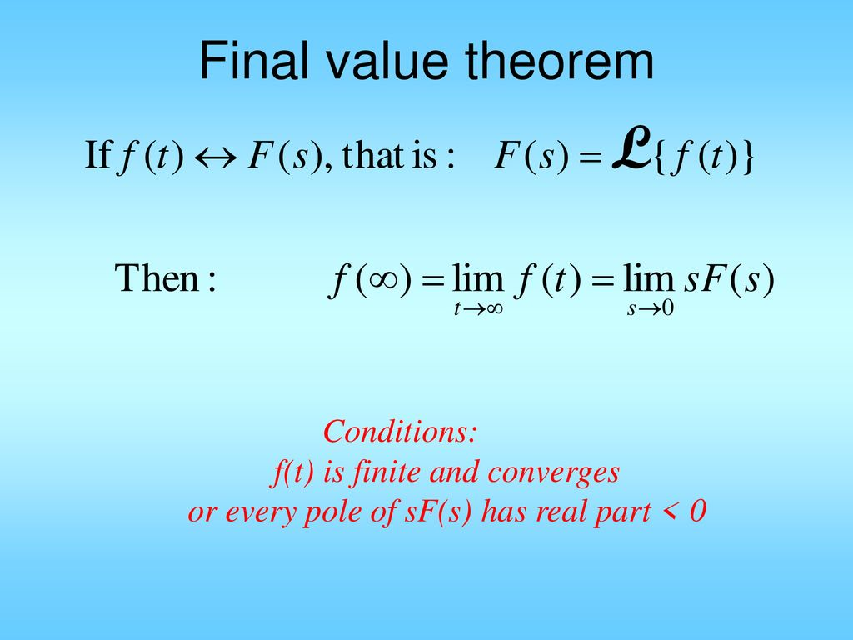
Final Valu Theorem
The Laplace transform is also useful to find the final value of the time function f(t).
Thus if F(s) is the Laplace transform of f(t) then the final value is,
The only restriction is that the roots of the denomintor polynomial of F(s) I.e. poles of F(s) have negative or zero real parts.

Slide 12
CONCLUSION
Linearity Property | A f₁(t) + B f₂(t) ⟷ A F₁(s) + B F₂(s)
Frequency Shifting Property | e^{s}₀^{t} f(t)) ⟷ F(s – s₀)
Integration | ^{t}∫₀ f(λ) dλ ⟷ 1⁄s F(s)
Multiplication by Time | T f(t) ⟷ (−d F(s)⁄ds)
Complex Shift Property | f(t) e^{−at} ⟷ F(s + a)
Time Reversal Property | f (-t) ⟷ F(-s)
Time Scaling Property | f (t⁄a) ⟷ a F(as)

Slide 13

THANK YOU

